Slide 1
Paragonimus westermani
(Oriental lung fluke)

Slide 2
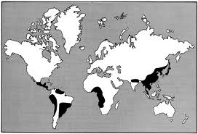
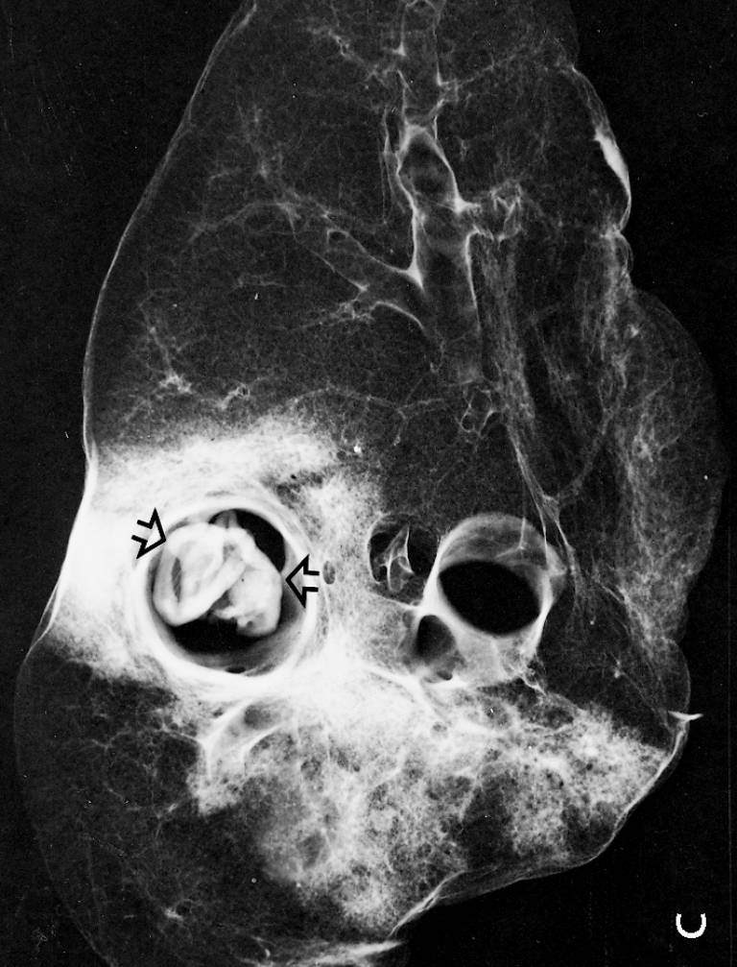
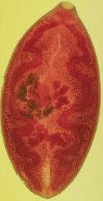
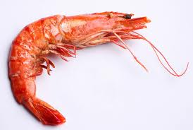
Paragonimus westermani causes Paragonimiasis
Geog. Distribution:
Asia, Africa, South America.
Encysted metacercaria
Adult lives in cystic pockets of lungs
Shrimps جمبرى
Crayfish جرادالبحر
Crabs سرطان البحر

Slide 3
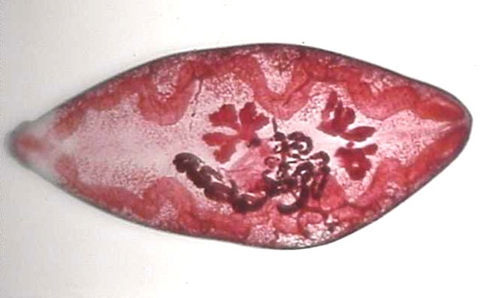
Paragonimus westermani
1-Thick bodies . Reddish brown in color
Oral sucker
2- Adult fluke (10x5mm) is ovate, rounded anteriorly and slightly tapering posteriorly
caeca
3- Cuticle is provided by spines
ovary
4- Oral & ventral suckers are equal in size, the latter is situated near the middle of body
5- Mouth leads to short esophagus & two simple intestinal ceacae.
testes
6- Two irregularly lobed testes present side-by-side in the posterior third of the body.
uterus

Slide 4
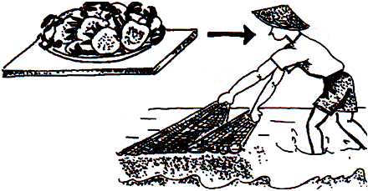
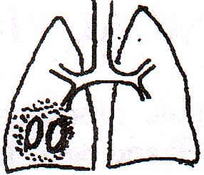
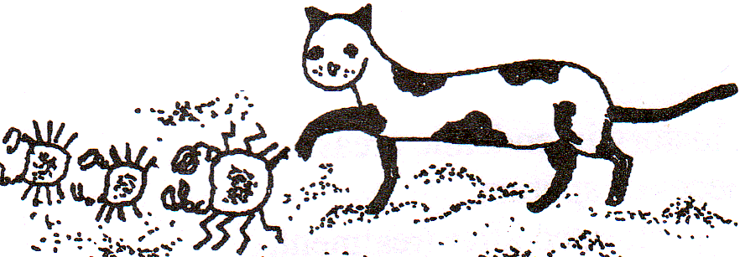
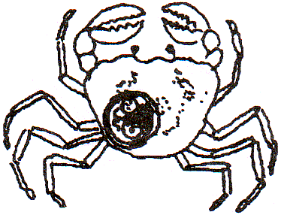
Life Cycle of Paragonimus
Infected man and fish-eating animal
Mode of infection
Ingestion of infected crabs,crayfish, shrimps
Final host
Cystic pockets in lungs
Habitat
Crab is the second intermediate host
Egg in sputum or stool
Diagnostic stage
WATER
Encysted metacercaria
Semisulcospira
Infective stage
miracidium
Snail is the first intermediate host
Small
tail
Micro-cercous cercaria

Slide 5
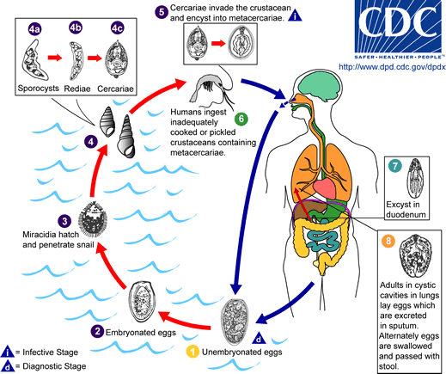
Life Cycle of Paragonimus

Slide 6
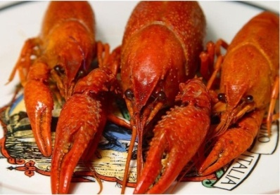
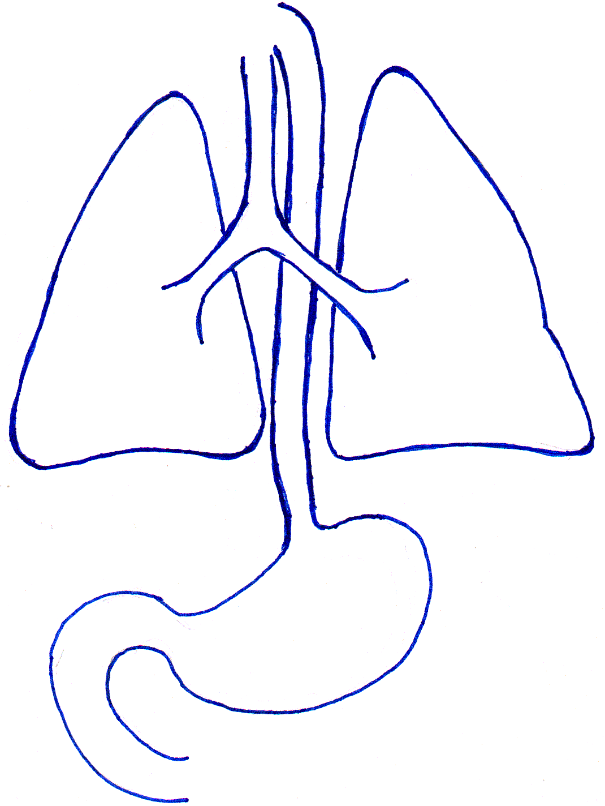
Development of Paragonimus inside the body of infected human
Pathogenesis
Granulomatous reactions around worms
Fibrotic encapsulation
Migration to ectopic sites
adult
Ectopic site
Clinical Picture
Pleura
Chest pain.
Ectopic site
Diaphragm
Chronic cough.
Brownish sputum may contain eggs.
Peritoneal cavity
Pleural effusion.

Slide 7
Pathology & Clinical Picture
♠ Pathological findings depend on load of flukes & chronicity of infection
♠ Light infections are asymptomatic.
♠ In symptomatic infection, acute phase is cc by diarrhea, abdominal pain &
urtecaria which correspond to invasion of intestine & subsequent migration of
larvae to the lung
♠ These symptoms last for several wks
♠ Followed by fever, cough, night sweat, dyspnea & chest pain .
♠ Chronic phase infection may be pulmonary or extra pulmonary
A- Pulmonary paragonimiasis
Chronic Phase
♠ The most common form
♠ Lungs show congestion with reddish brown nodules
♠ Nodules composed of cysts containing adult worms usually in pairs & brownish,
necrotic gelatinous exudates containing ova & Charcot Leyden crystals.
♠ Cyst wall is thick and contains granulation tissue with plasma cells, lymphoid
cells, eosinophils & fibroblasts
♠ Bronchial mucosa is congested &oedematous.

Slide 8
Pathology & Clinical Picture
A- Pulmonary paragonimiasis (cont.):-
♠ Presented clinically by
♠ Low grade fever.
♠ Cough with chocolate coloured sputum beaded with eggs
♠ Night sweat, severe chest pain, dyspnoea
♠ Recurrent attacks of bronchial pneumonia & haemoptysis.
♠ N.B.
The condition mimics pulmonary TB
B- Extra-Pulmonary paragonimiasis
♠ Migrating metacercariae may remain in peritoneal cavity or lodge in other organs
e.g. liver, spleen, kidney, eye, brain,….

Slide 9
Diagnosis
I- Clinically:
Chest pain, productive cough and diet history in endemic areas.
II- Laboratory:
1- Detection of eggs in sputum or faeces .
2- Immunodiagnostic tests: detect early and chronic
infection (ELISA and CFT )
3- Blood film examination to determine %age of
eosinophila
III- Plain X-ray of chest and computerized tomography.

Slide 10
2- Immunodiagnostic Tests
1- Detection of Paragonimus eggs
In sputum or stool
S : 90 X 55 µ
S : oval, thick-shelled, opercutated at one pole,
thickened at the other pole
C : brown C : immature ovum
a- Enzyme-linked Immunosorbent Assay (ELISA)
Paragonimus Ag
Patient’s serum
Ab linked to enzyme
substrate
wash
wash
wash
ELISA plate
Coating well with Paragonimus Ag to detect anti-Paragonimus Ab in patient’s serum

Slide 11
Patient’s serum
Ab linked to enzyme
MAb
substrate
wash
wash
wash
Coating well with anti-Paragonimus Ab to detect Paragonimus Ag in patient’s serum
2- Immunodiagnostic Tests
b- Complement fixation test (CFT) for antibody detection in patient’s serum
Paragonimus antigen
Complement
Antibodies in patient’s serum
No Antibodies in patient’s serum
Fixation of complement
No fixation of complement

Slide 12
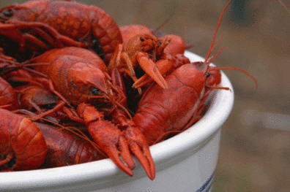
Blood Film Examination
Eosinophilia
(20-25%)

Slide 13
Computerized tomography
Plain X-ray
تصوير مقطعى يظهر على شاشة الكمبيتر
Adult Paragonimus worms
X-ray chest show patchy foci of fibrotic changes with ring shadows
CT & MRI show cerebral cysts in cerebral paragonimiasis
Treatment
Praziquantel
Adult worms may be expectorated after treatment

Slide 14
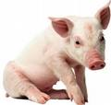
Epidemiology and Control
Epidemiology:
Ingestion of raw or incompletely pickled, wine or brine-soaked infected crabs, crayfish & shrimps
Pigs and small animals are paratenic hosts.
Paratenic host: A host which carries the parasite in an arrested form.
Ingestion of metacercariae during preparation of these fish via contaminated hands or utensils
Control:
Treatment of cases.
Proper cooking of crabs, crayfish and shrimps.
Health education.
Snail control.

Slide 15
Larva migrans
Migration of larvae of nematodes in unsuitable hosts.
Larvae cannot complete their normal development into adults.
Cutaneous larva migrans
Visceral larva migrans
Invasion of human skin by filariform larvae of A.caninum & A.braziliense
Invasion of human viscera by larvae of Toxocara canis & Toxocara cati

Slide 16
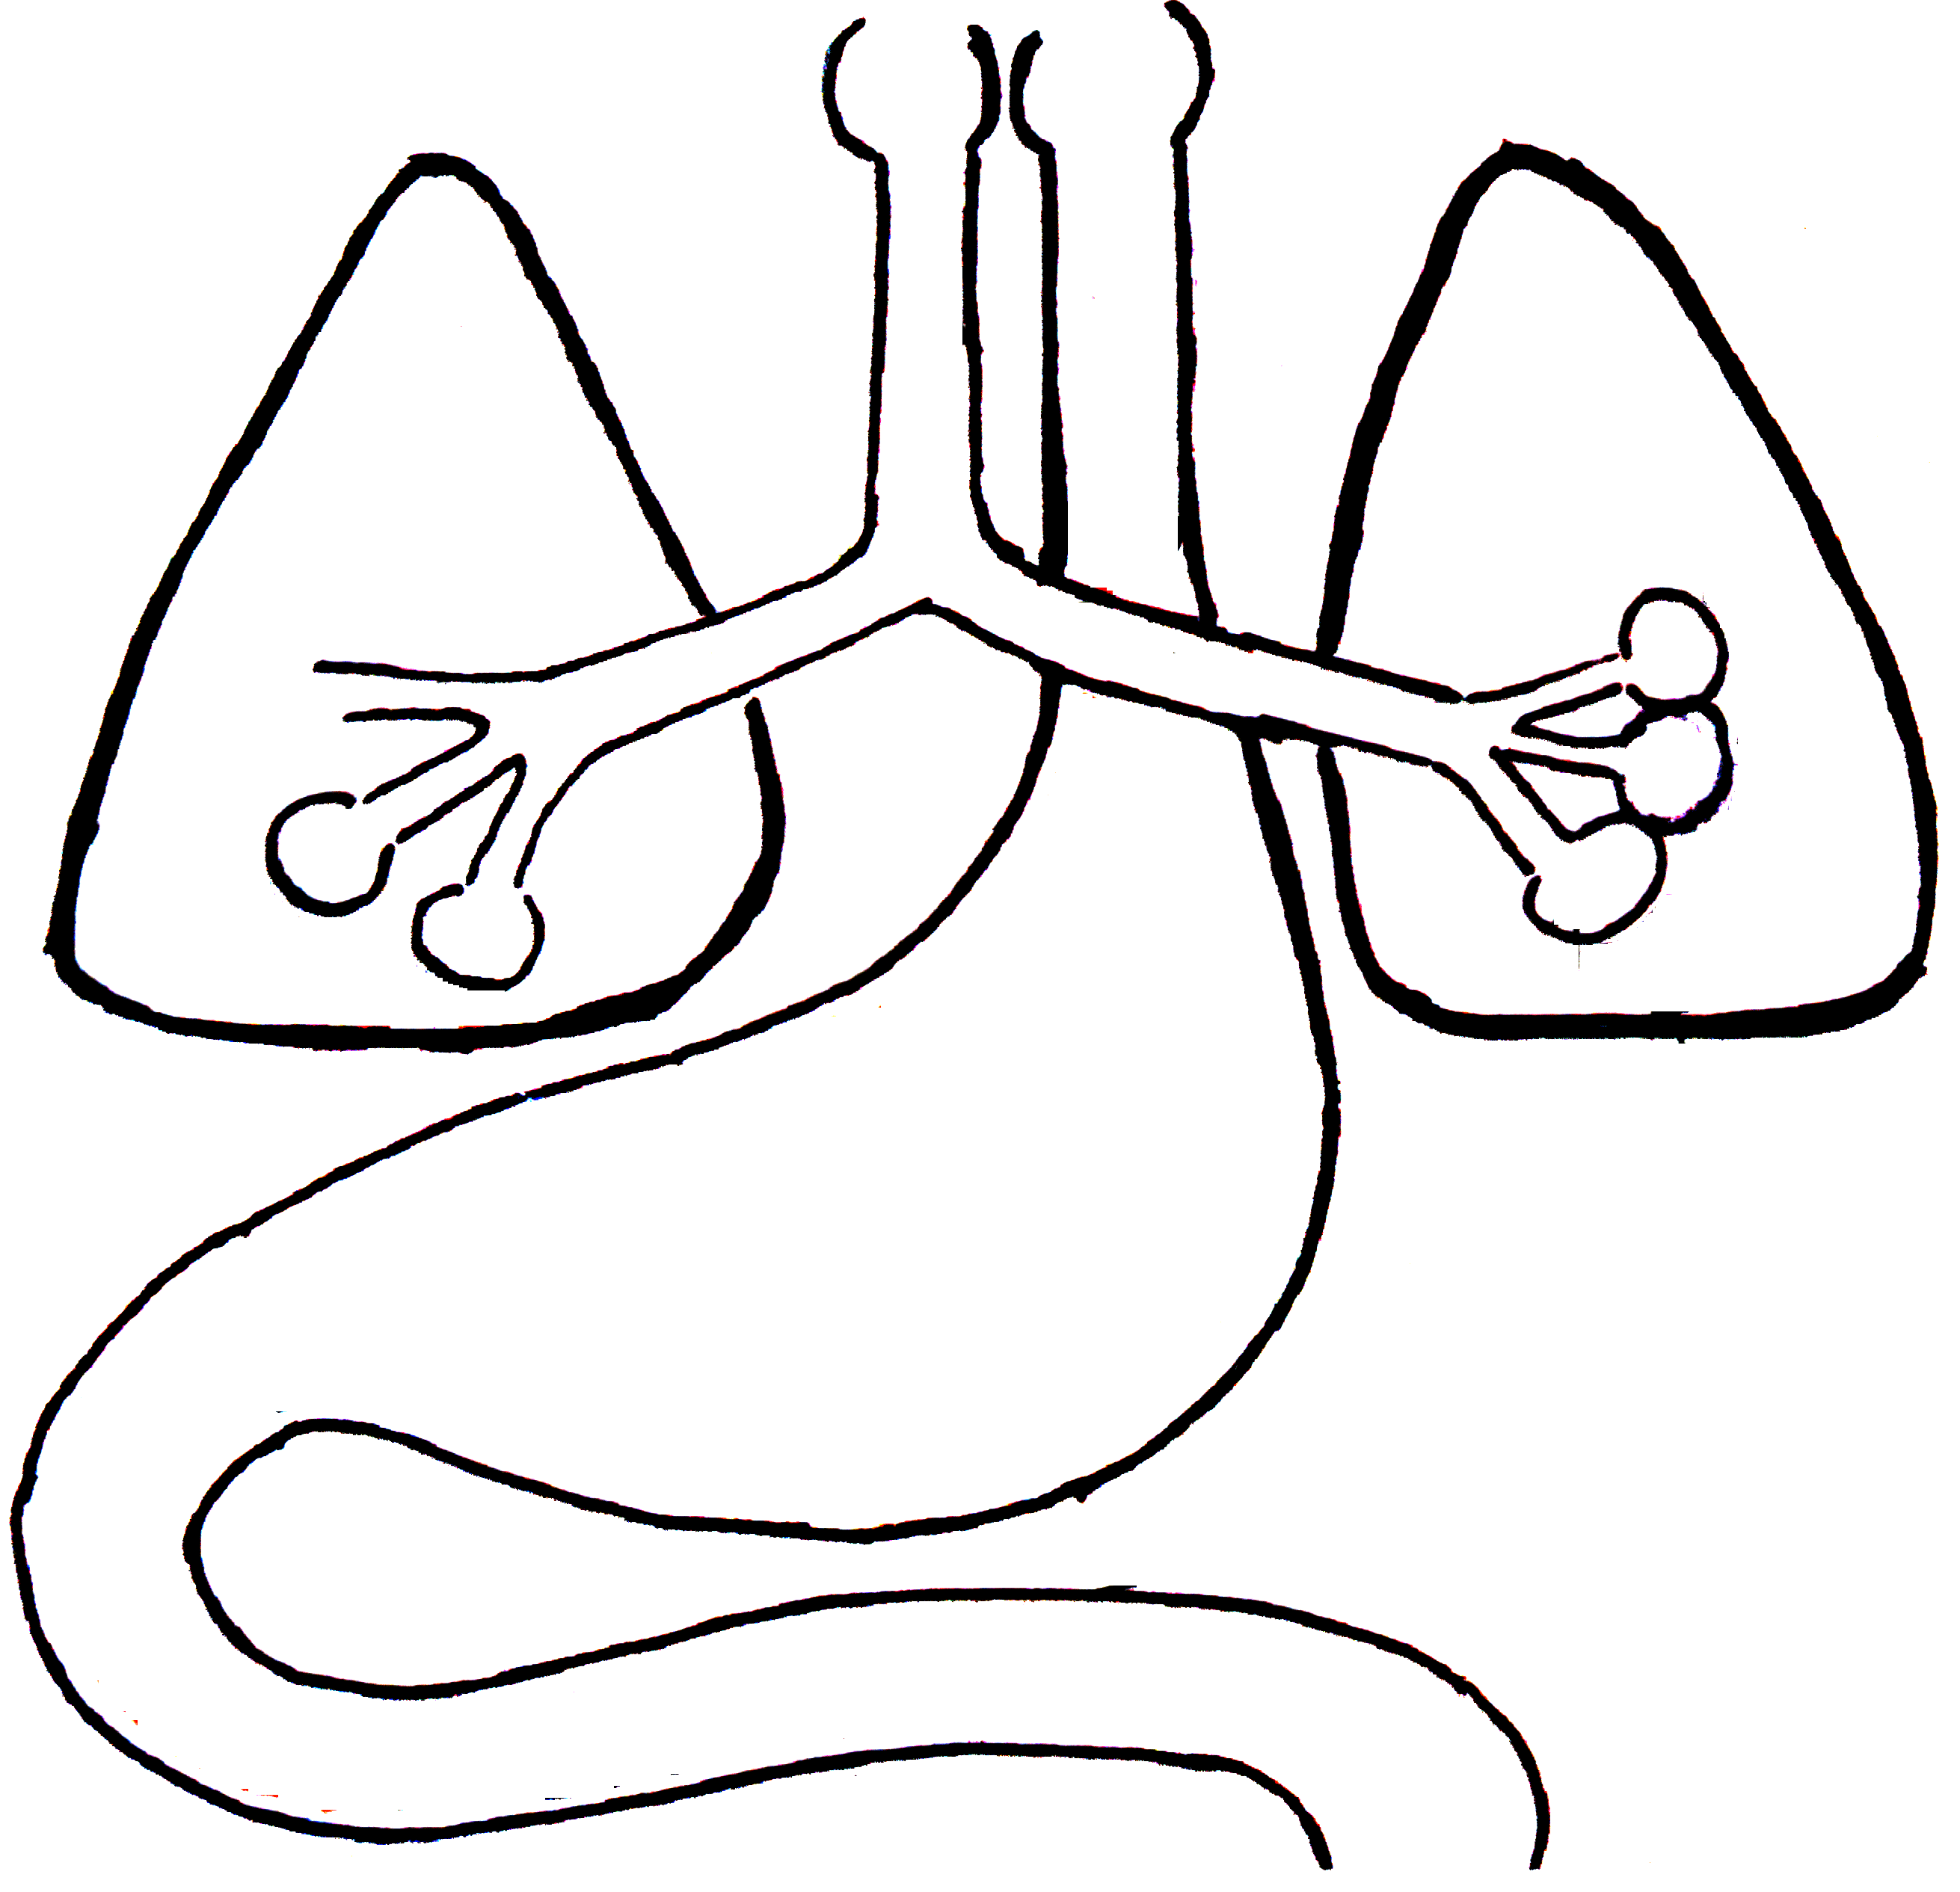
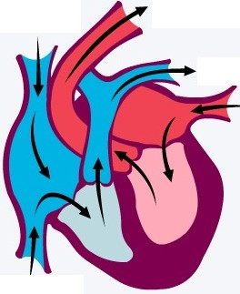
What happens when man ingests
Embryonated A.lumbricoides egg ?
Larva is swallowed
2nd moult
Rhabditiform larva
Venous circulation
Adult Ascaris in small intestine
3rd & 4th moults

Slide 17
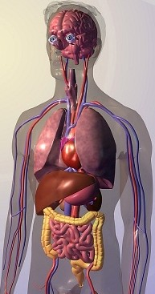
What happens when Man ingests
Embryonated
Toxocara canis egg?
Toxocara cati egg?
Visceral larva migrans
Blood vessel
Lymph vessel
Eosinophilic granulomatous lesion

Slide 18
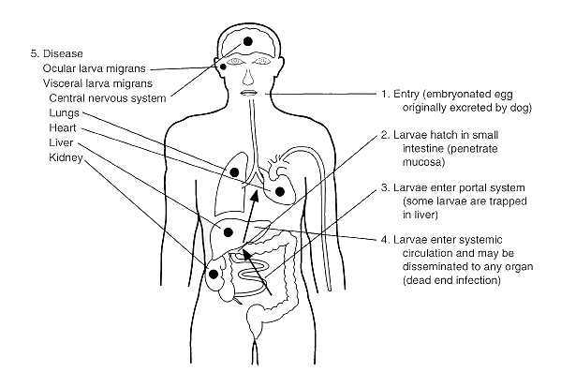

Slide 19
Pathogenesis and Clinical Picture of VLM
Eosinophilic granulomatous lesions in viscera.
Most frequently seen in the liver.
Persistent eosinophilia with no symptoms.
Usual picture:
Child – history of close contact with soil, dogs or cats.
Larvae reaching the liver Enlarged tender liver.
Larvae reaching the eye Visual disturbances.
Larvae reaching the brain Neurological disturbances.
Larvae reaching the lungs Pneumonitis.
lymphocytes
eosinophils
Foreign body giant cells

Slide 20
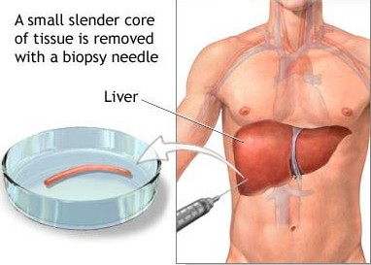
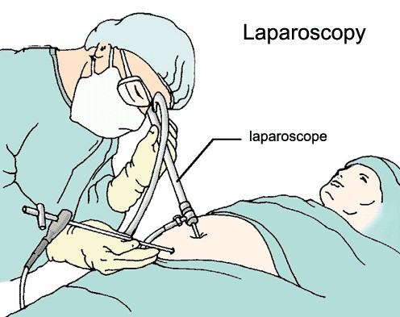
Diagnosis of Visceral Larva Migrans
Clinical
Laboratory:
1- Laparoscopy and biopsy of liver nodules.

Slide 21
Diagnosis (cont.)
2- Serological tests (IHA, IFA, ELISA):
larvae trapped in human tissues producing a state of chronic infection. This causes over-stimulation of the immune system producing increased amounts of:
- IgM, IgG and IgE against larval Ag.
- Anti-A and Anti-B isohaemagglutinins.
Iso haemagglutinins: naturally occurring antibodies in patient’s serum against ABO group antigens on human RBCs.
Larval antigens are similar to ABO antigens
- Eosinophilia (20 - 80%)

Slide 22
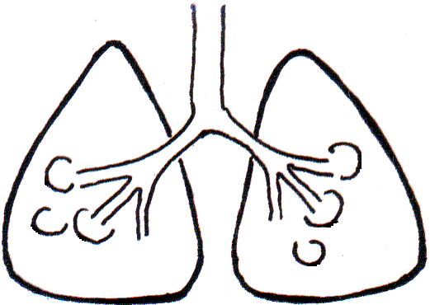
Other causes of Visceral larva migrans
In heavy infection: Occasionally, larvae of A.lumbricoides, A.duodenale or S.stercoralis fail to enter inside lung alveoli and are swept by the systemic circulation to settle in different organs of man.
Larvae in arterial blood to viscera
Larvae in venous blood

Slide 23
Treatment of Visceral Larva migrans
1- Thiabendazole orally
Repeated after one month
2- Corticosteroids
In severe cases
Prevention and Control of Larva migrans
Pet dogs and cats de-wormed.
Stray dogs and cats eliminated.
Avoid contaminated food, drink and hands

